Slide 1
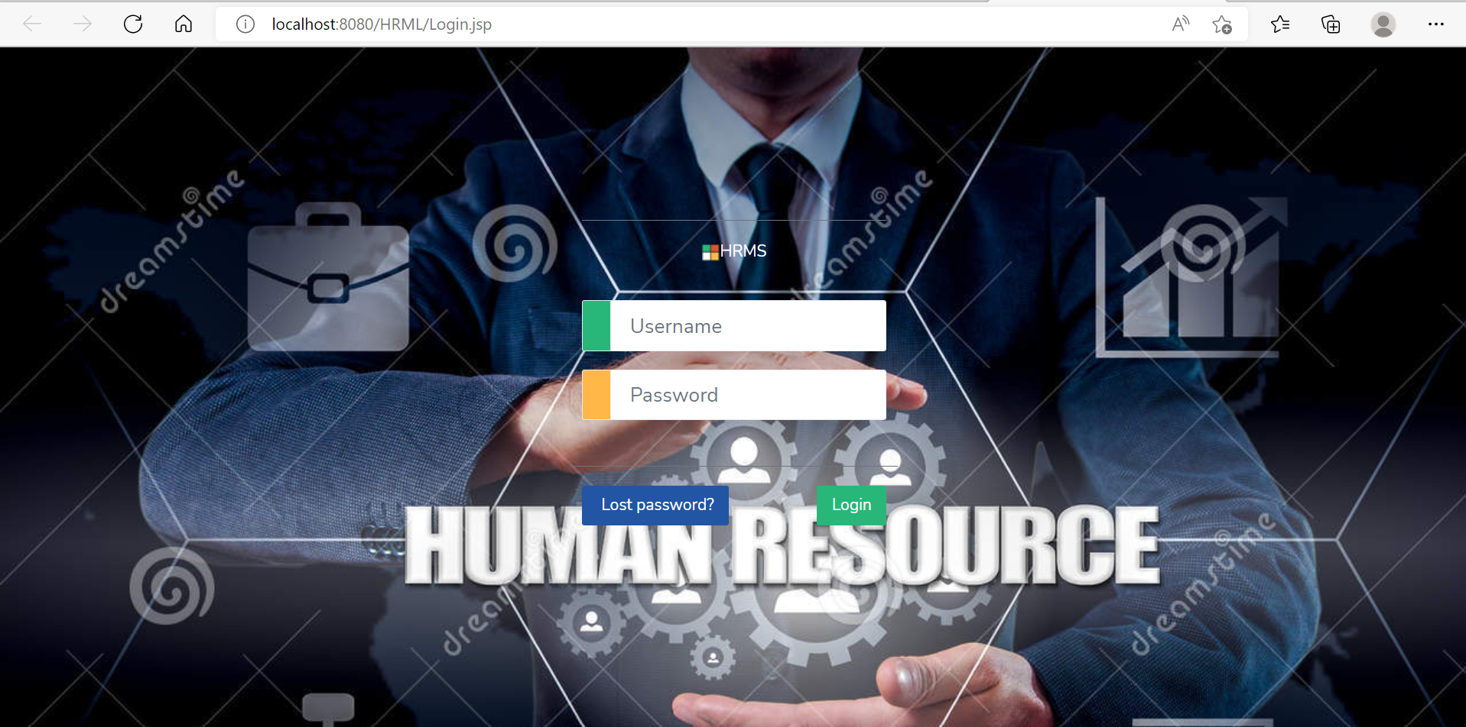
HRMS
-Human Resource Management System

Slide 2
ACKNOWLEDGEMENT
On presenting this project report, I wish to express my deep thoughts to number of people who contributed to the completion of this project.
I am grateful to our respected Principal Mr. Ganesh Raut sir for providing all facilities for the development of our project, I also express my heartfelt gratitude to Mrs. Deepali Thorat Mam my project guide for rendering all possible help and support during the development, implementation and presentation of the project.
I am extremely grateful to Mrs. Deepali Thorat Mam Lecture-in-charge of our project for her valuable guidance and encouragement throughout my humble endeavor.

Slide 3
Table of contents
Super admin
ADD organization page
Update Organization
Add HR (Human Resource)
View HR (Human Resource)
Update HR (Human Resource)
Delete HR (Human Resource)
ADD organization Image
Change Organization name
Current date & time
Search HR (Human Resource)
Sort HR (Human Resource) by all keys
Logout
HR (Human Resource)
ADD Student page
Update Student
View student data
Add Call answer
View call answer
Search Student
Delete student
Current date & time
Sort student by all keys
Email student
Logout

Slide 4
Introduction
Topic name : HRMS (Human Resource management system)
Team members : Amol Yadav
Platform : Front-End: JavaScript, CSS, bootstrap,
Json, ajax, Jquery, JSP
Back-End : JSP, Servlet, Java
Database : Mysql
server : Apache tomcat 10, Jakarta package

Slide 5
INTRODUCTION OF PROJECT:
HRMS is a management software. It is user in all management environment Like collage management system, Class management system, office management system etc.
In that software we are creating two role(login). First is Super admin and second is HR (Human Resource management system). Super admin can add the HR (Human Resource management system). There are only one organization are present in system after one organization is added then super admin can only update it. Super admin cannot add the another organization. Super admin can change its organization name, logo ,email, address, email, contact, username and password.
there are five phases in that software calling phase, waiting phase, working phase, account phase, delivery phase. This website deals with this five phases. We are using this project as is for class management project. Once this phases are completed one student working period done. Then HR can remove that student from our system. HR search for new student and continuously this phases are run by HR for the add student.
We are trying to expand its limit to add super admin multiple organization and HR and build for the large management website platform for the people.

Slide 6
SCOPE & OBJECTIVES
This website helps how to manage there organization easily and store data into database for future purpose ex. Classes manage there teachers and teacher manage there students, manager manage there HR and HR manages there employees, etc.
This website provides management platforms for all over industry.
Using this website work of any HR are easy and in flow. Don’t remember of the each student response, student work ,student fees details , which student was not pay the fees etc.
All information and alert are give to the HR about student.

Slide 7
EXISTING SYSTEM
We will provide only the calling phase, waiting phase, working phase further phases implement in next session.
When HR call the student then student in calling phase, if student gives response it is recorder by system. If the student gives positive response then student go to the waiting phase, if student gives the admission then it will go to the working phase. That phases are know into the student last call history.
HR can update student information.
HR can remove student.
HR can email student.
Super admin can add multiple HR.
Super admin can update HR.
Super admin can delete HR.

Slide 8
There are two roles first is super admin second is HR.
HR can call Students and response will recorded in call history with clicking call button.

Slide 9
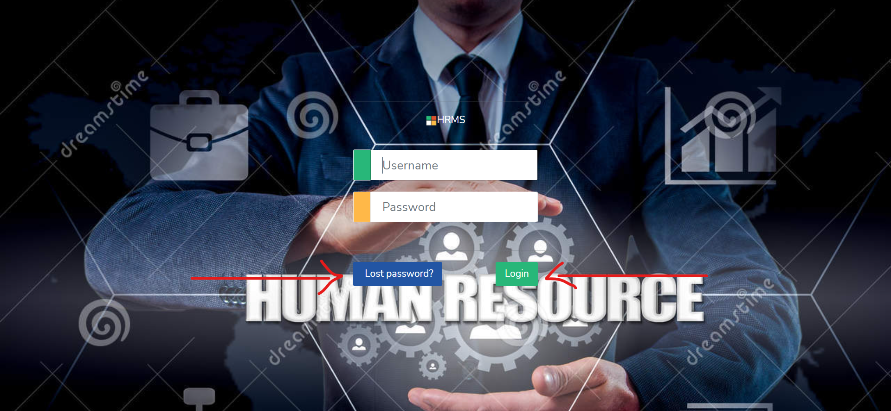
Login page

Slide 10
You can login using username and password credentials.
If you are super admin then after login redirect to the add organization page.
If you HR (Human Resource) the you can redirect to the Add HR page.
If you have enter the wrong credentials then you go message “Sorry Invalid UserName and Password !”.
If you have lost password the click on lost password button show in above image. After clicking lost password you have enter your email address for password recovery. If you can enter the wrong email then it will not excepted they disable the button to avoid further process. Wrong email means that email is not present in your database.
If you can enter the correct email address then button is enable and after click on recover button and open the modal you can update the password.

Slide 11
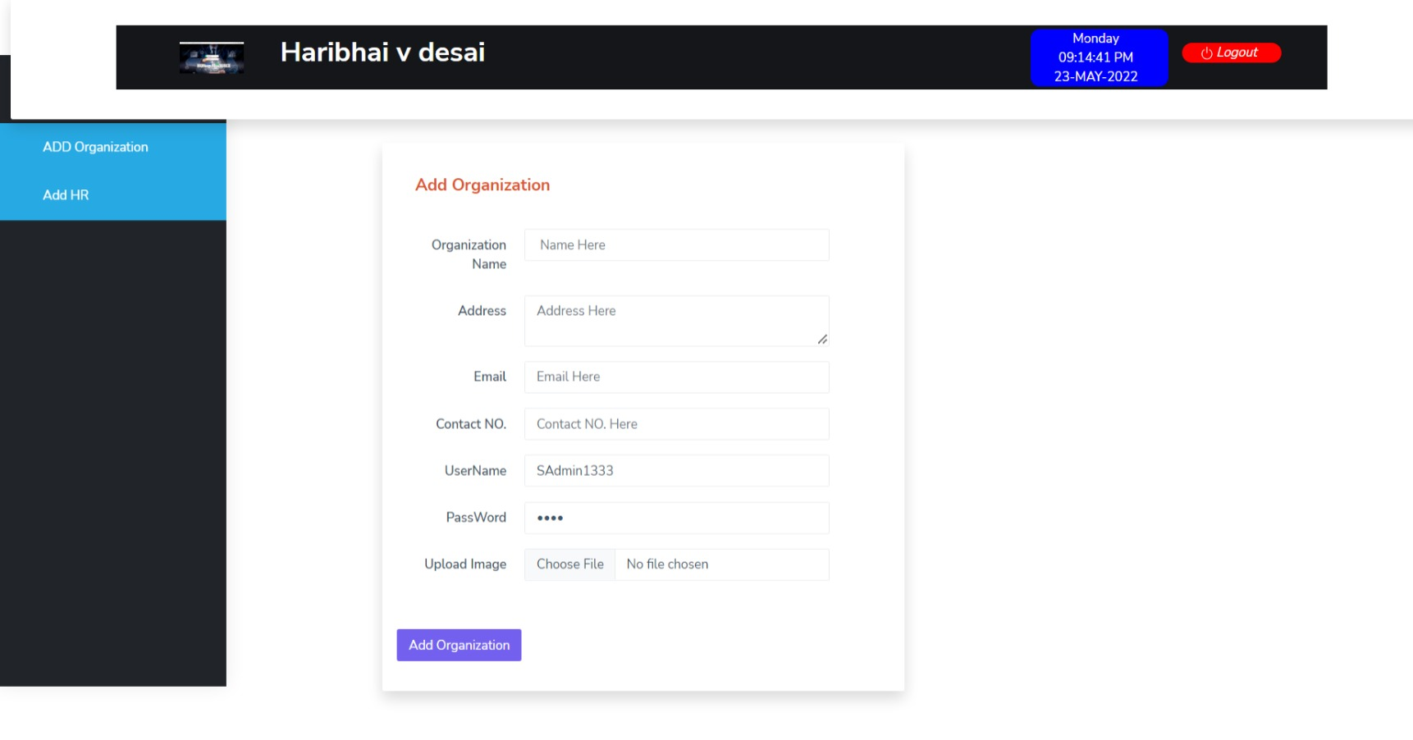

Slide 12
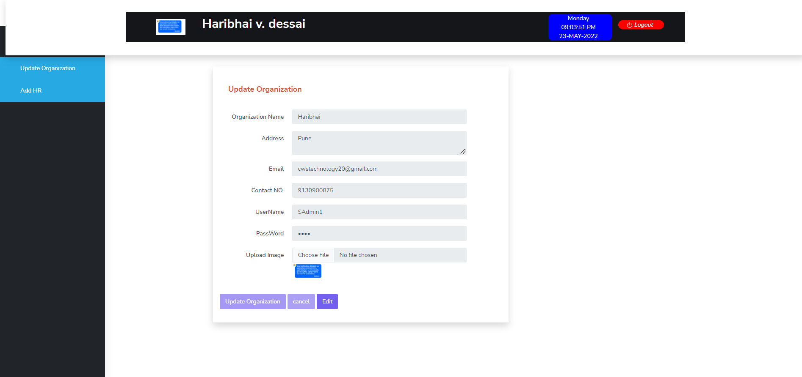

Slide 13
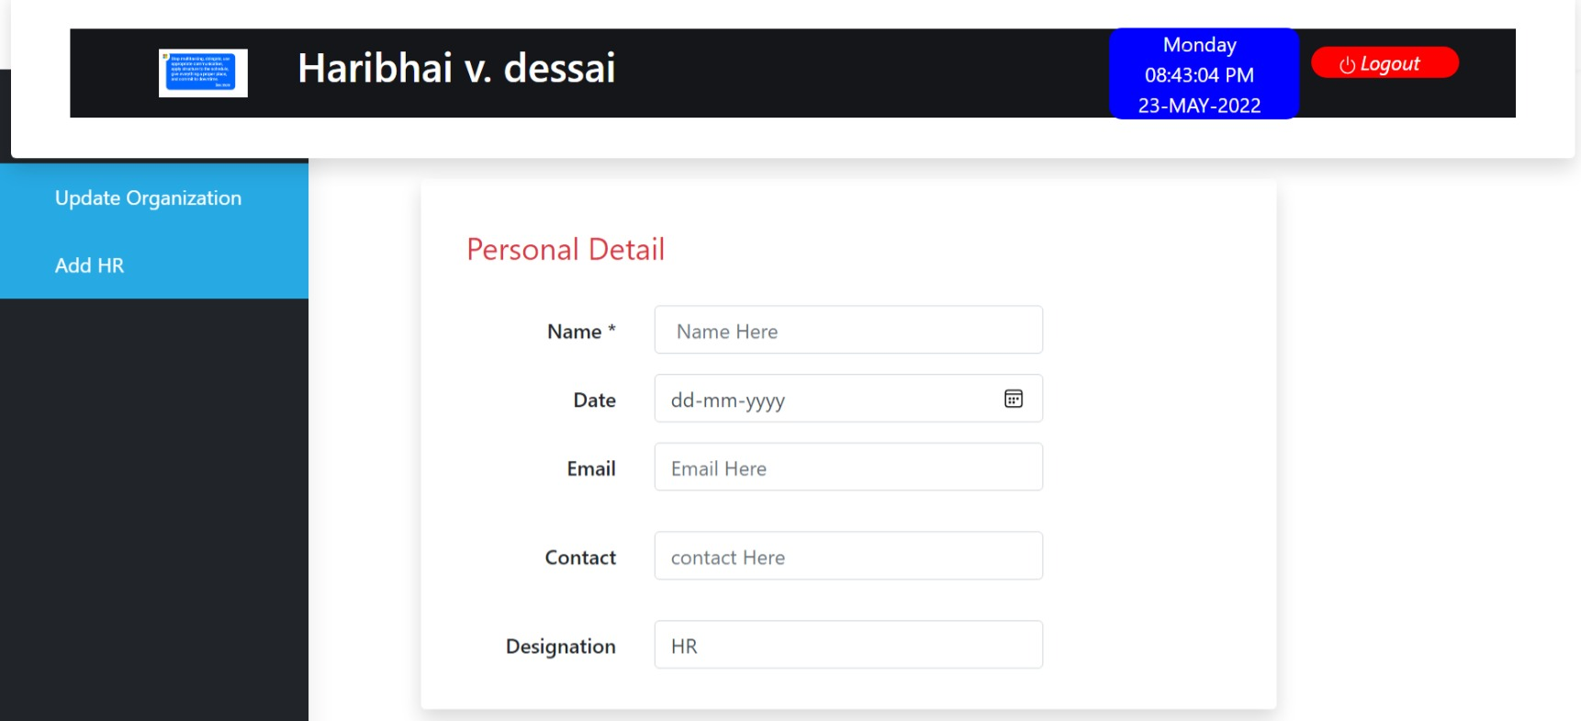

Slide 14
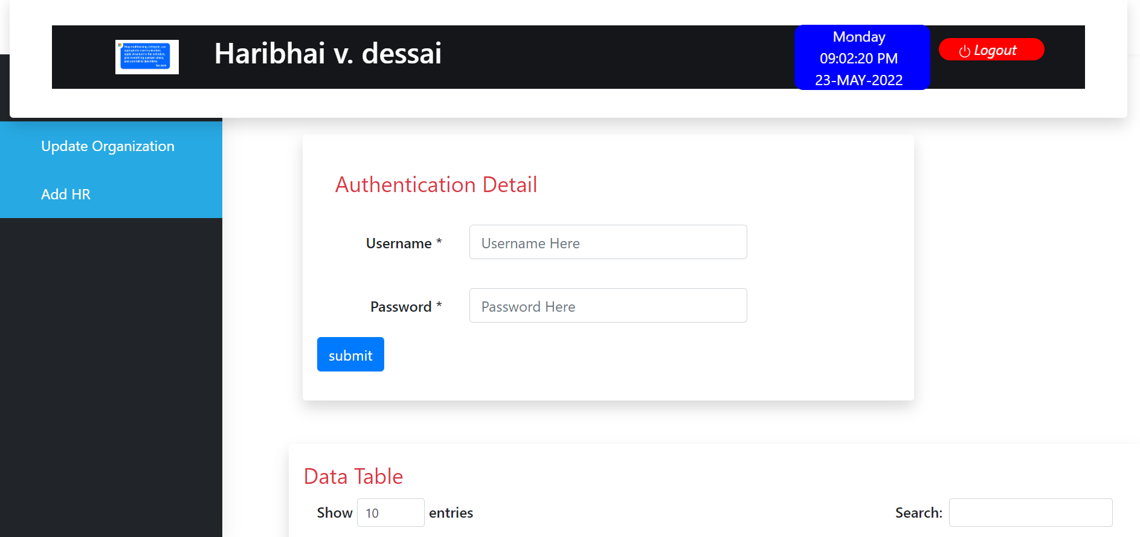

Slide 15
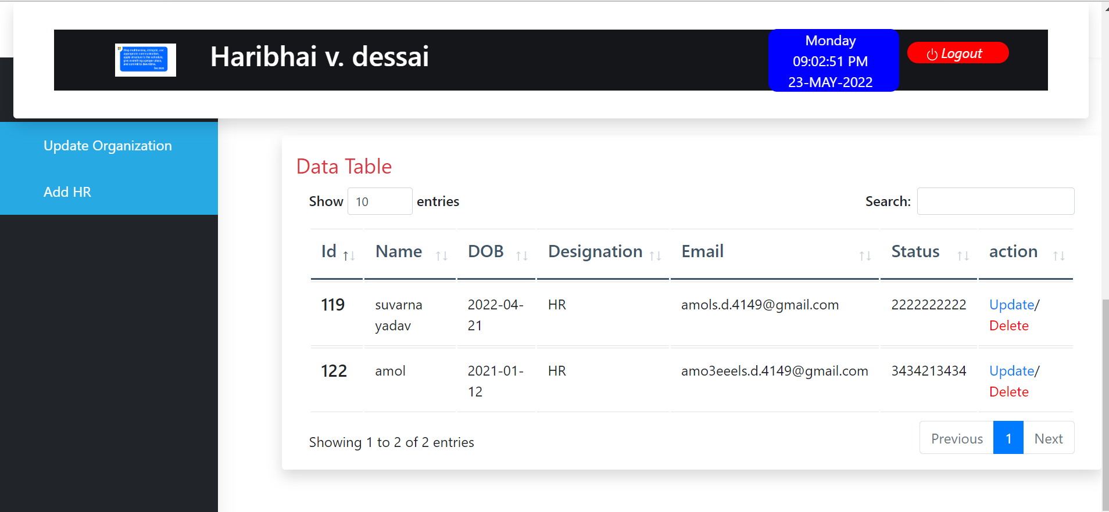

Slide 16
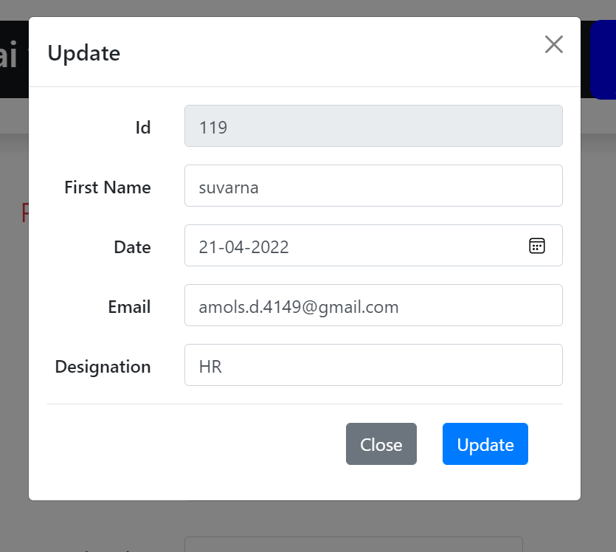

Slide 17
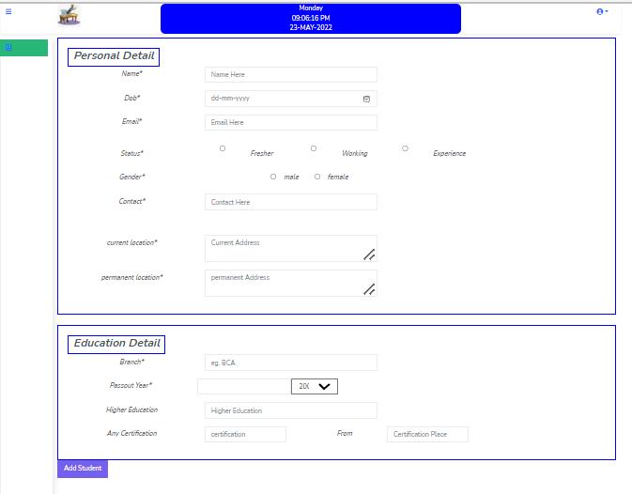

Slide 18
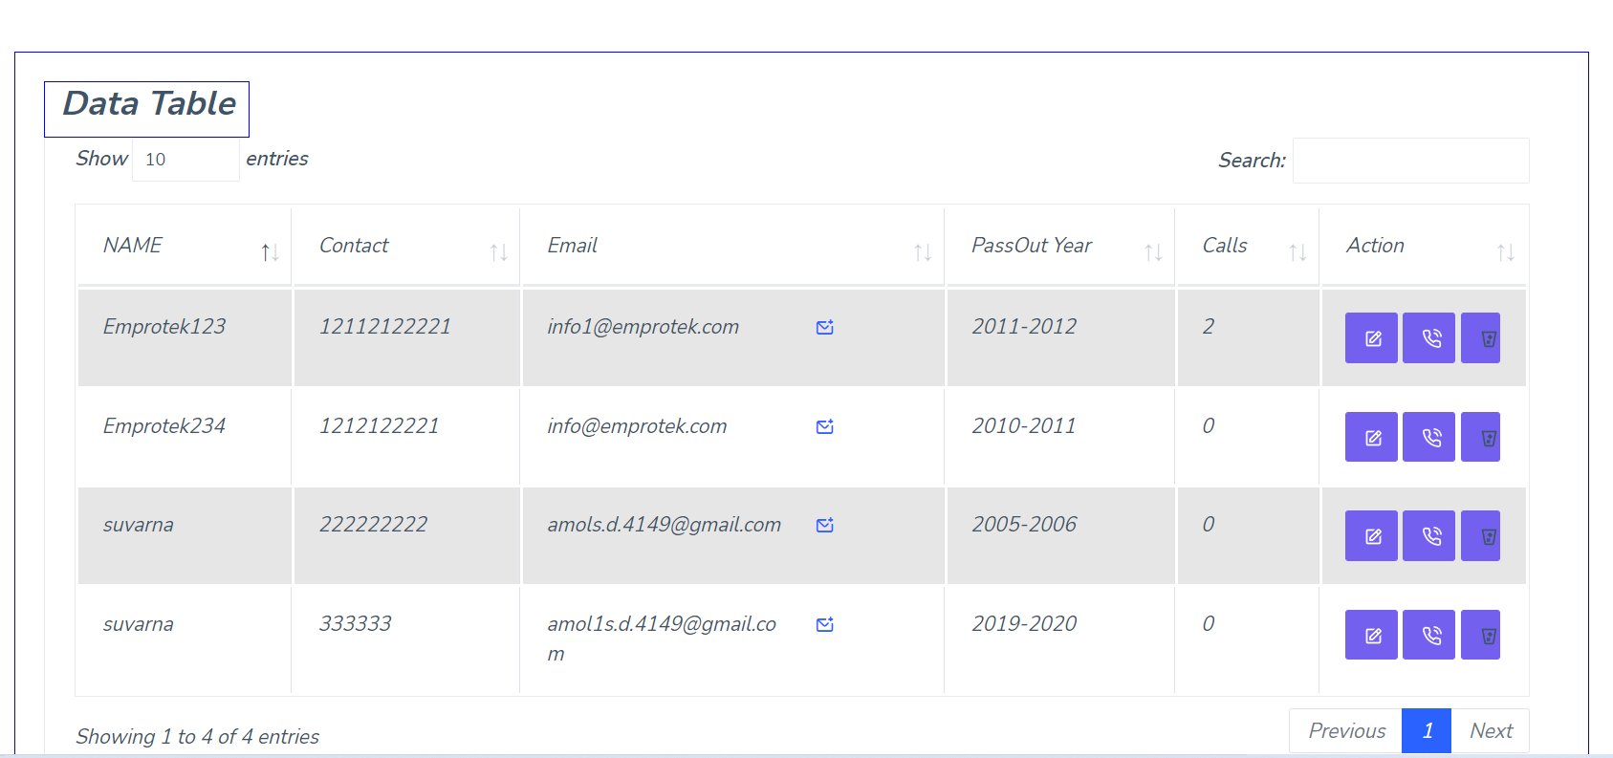

Slide 19
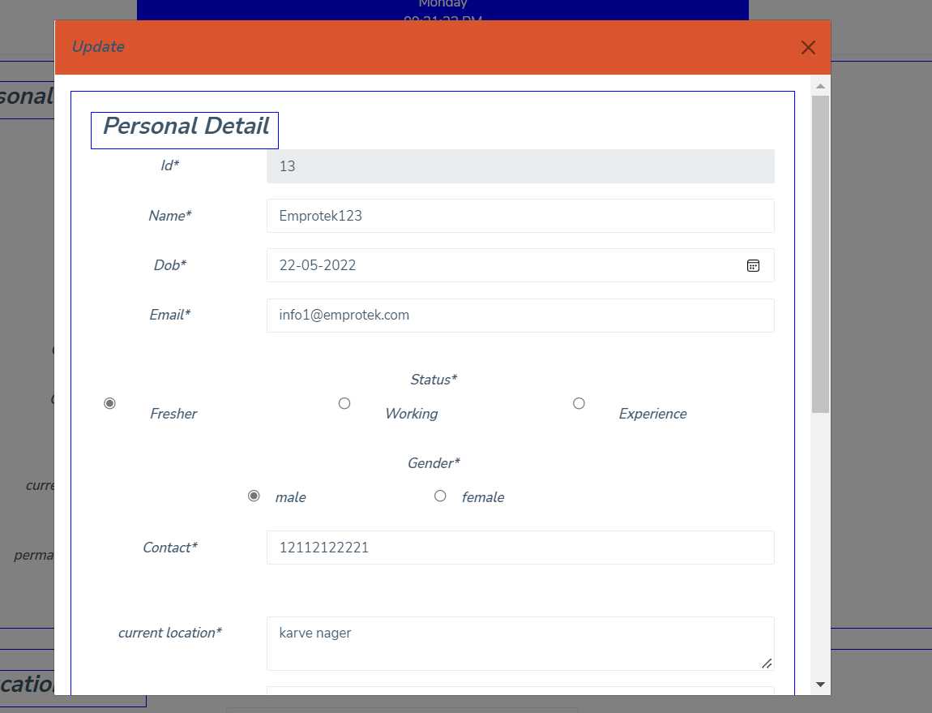

Slide 20
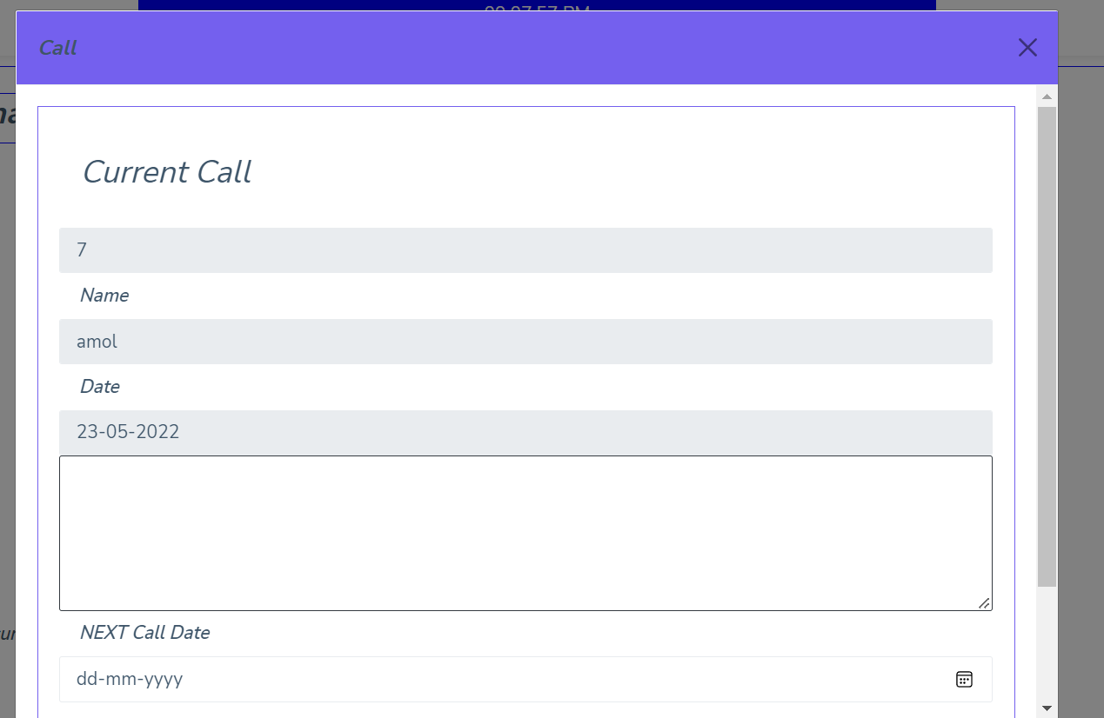

Slide 21
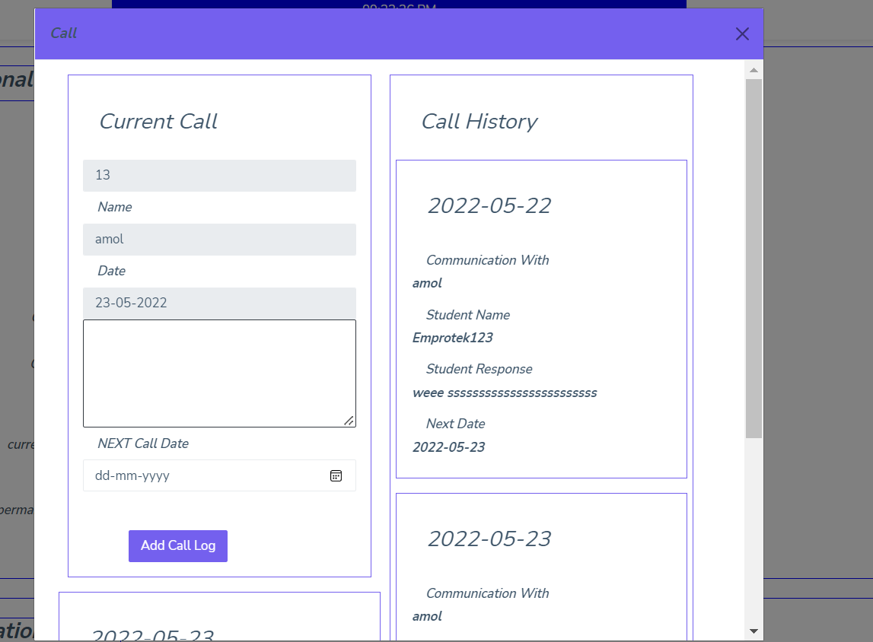

Slide 22
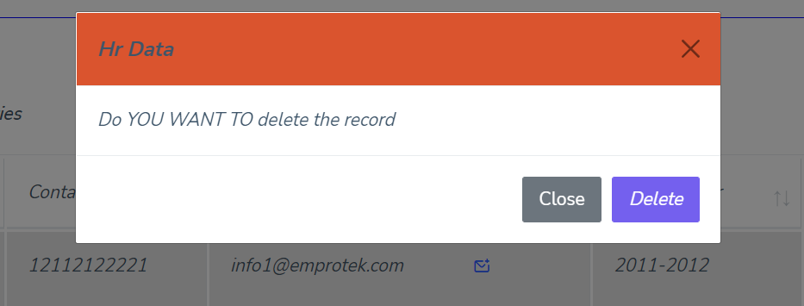
Delete student

Slide 23
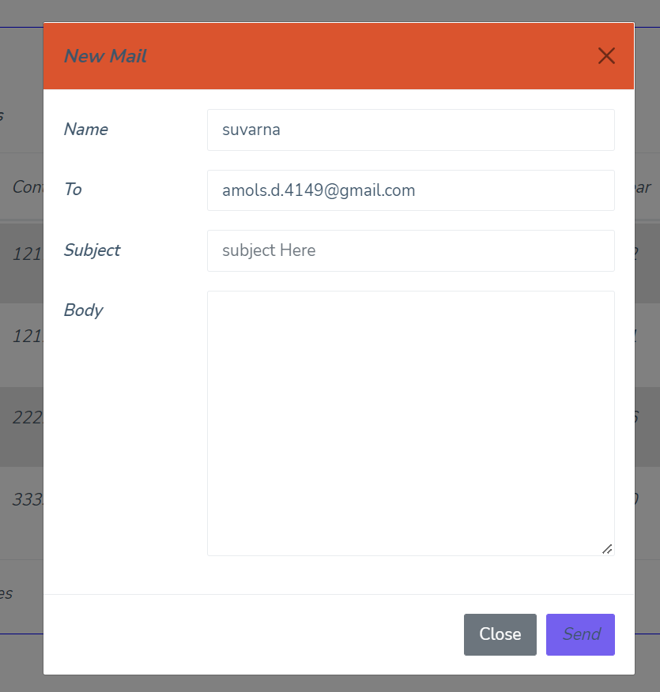
Email

Slide 24
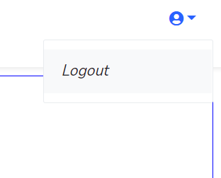
Logout

Slide 25
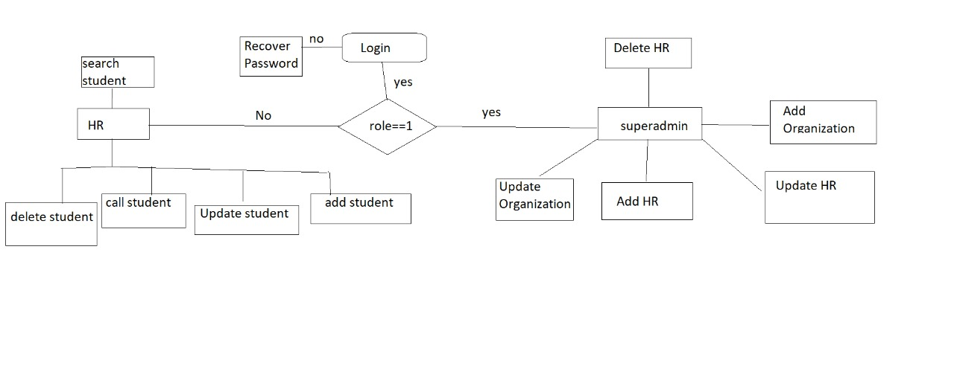
ER Diagram

Slide 26
Add organization
Only one organization is present in HRMS
Add organization with its data
User name, contact, Email must be unique
After adding organization your Organization name will apeare on dashboard with your organization logo.
Current time, date and day is display on dashboard.
After add you can only modify your organization name.

Slide 27
ADD HR (Human Resource)
Add HR with (Human Resource) its data
User name, contact, Email must be unique
After adding HR you will display HR added successfully pop up.
Current time, date and day is display on dashboard.
You can add multiple HR.

Slide 28
View HR (Human Resource)
You can view your hr details in HR data table.
In that table you can modify and delete HR.
You can search HR by any field.
You can sort alphabetically any column.
You can increase your pagination record.

Slide 29
Modify HR (Human Resource)
You can view your HR all details in HR modal.
You can modify selected HR.
You can change your password, email, contact etc.

Slide 30
Delete HR (Human Resource)
In data table after click on delete icon you will get a pop up with warning message.
Warning message : “do you want to delete”
There are two buttons yes and close.
If you click on yes delete the record.
If you click on close button data not deleted.

Slide 31
Add student
Add student with its specific data.
You should fill all form data otherwise you cannot click on add button.
Add button will disable.
If you fill all form details then you get a message data added successfully.

Slide 32
View student
You can view your all student records in data table.
You can search Student by any field.
You can sort alphabetically any column.
You can increase your pagination record.
There are three buttons update, call and delete button.
In that email field there are email field button .

Slide 33
Email
In that email field there are email field button .
After click on email button you will get selected student email address into the to section.
Type your subject, body and mail to that student.

Slide 34
Update student
You can update student by click on edit button icon on data table.
After click on edit button icon opens the modal and you can view your all students data and you can change it.
In that modal there are two button update and close.
After click on update button you will get a pop up message.
Data updated successfully.

Slide 35
Call
In that call button there are two types of modal is open.
First is without history means first call.
modal opens in full page mode.
If you can call any student there counter increase in data table.
If any student counter is greater than zero then you will change the modal to history modal.
In that modal you can add your new call record or see your all and last call history with student response and next call date.

Slide 36
Delete student
HR can delete the student if student switch the class or any other issue.

Slide 37
HR Dashboard
In that dashboard you can see the current date and time.
You can log out by click on profile icon.

Slide 38
Organization Dashboard
In that dashboard you can see the current date and time.
You can log out by click on profile icon.
You can see the Organization name and Logo.
In that side bar there are two options.
1. Add or update Organization.
2.Add HR.

Slide 39
Future enhancement
Future Enhancements
Scale up the website
Adding multiple organizations
With respect to organization and HR data
Increase roles
Video calling functionality

Slide 40
BIBLOGRAPHY
https://en.wikipedia.org/wiki/Human_resource_management_system
https://getbootstrap.com/docs/4.0/getting-started/introduction/
https://tomcat.apache.org/download-10.cgi

